Slide 1

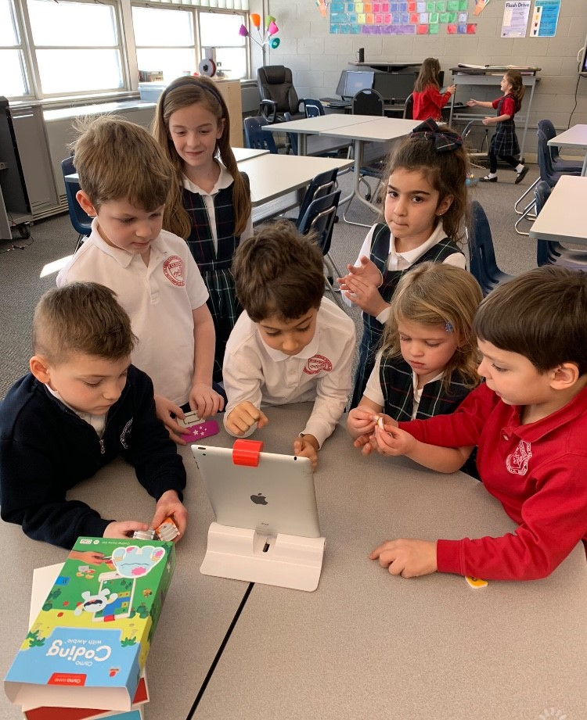
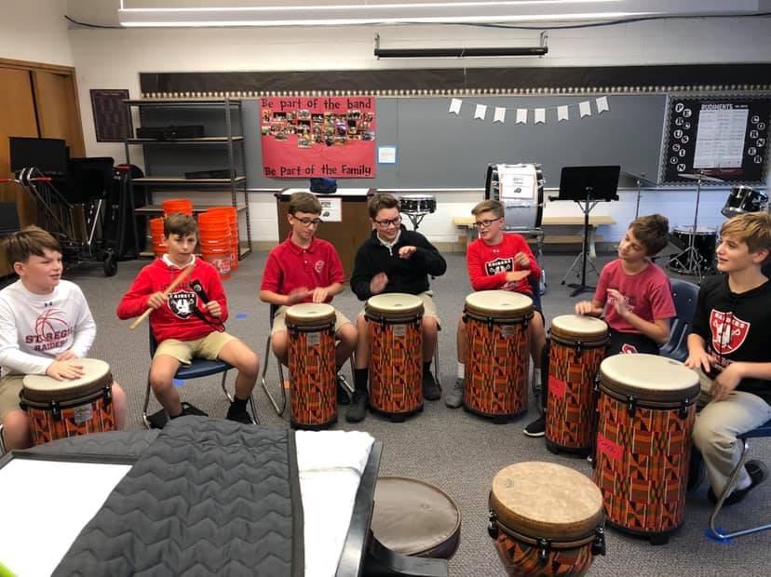
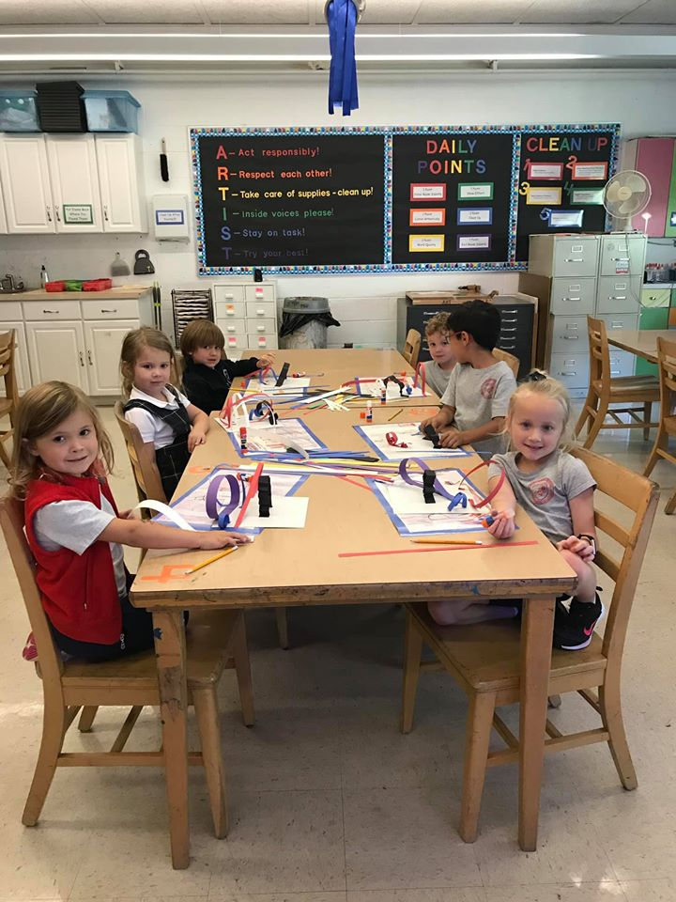

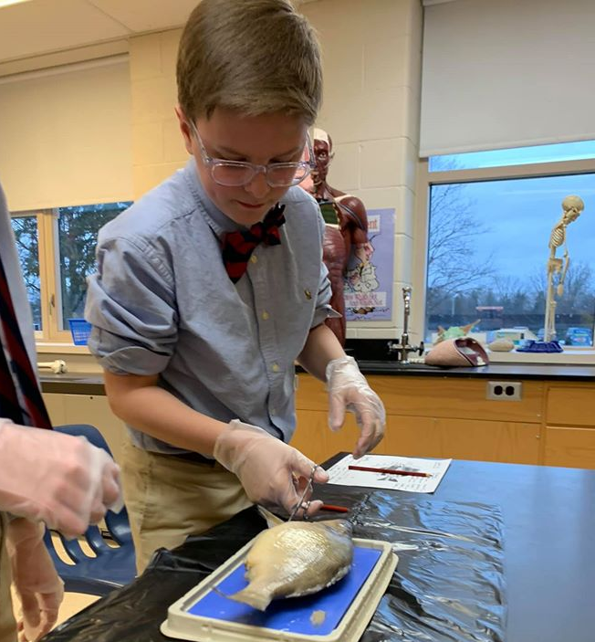
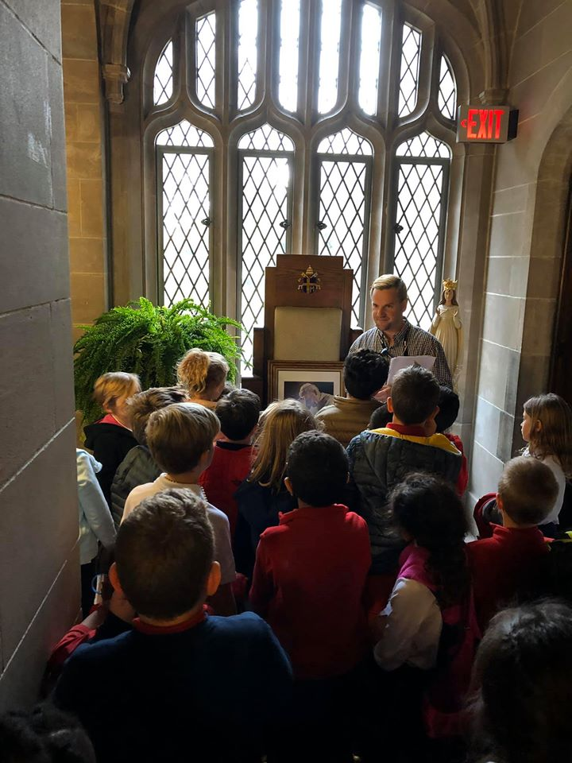
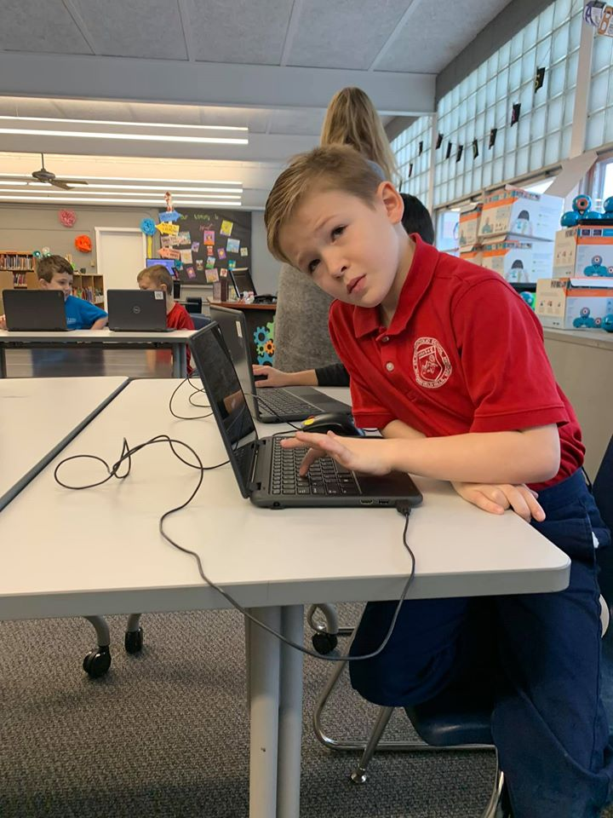
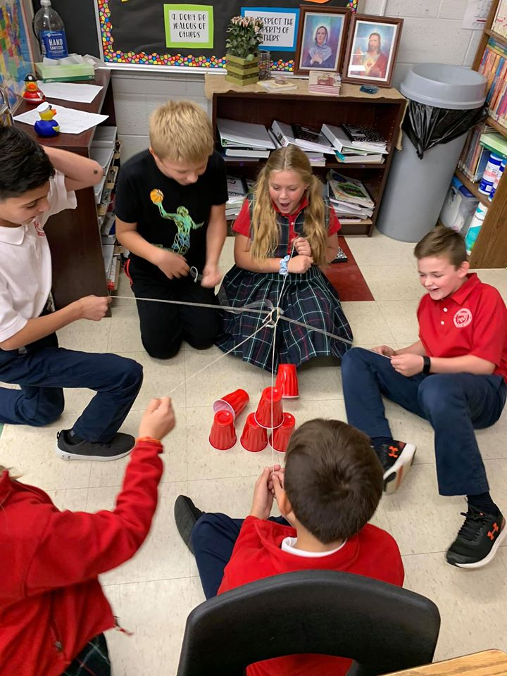
2020-2021 Return to school plan

Slide 2
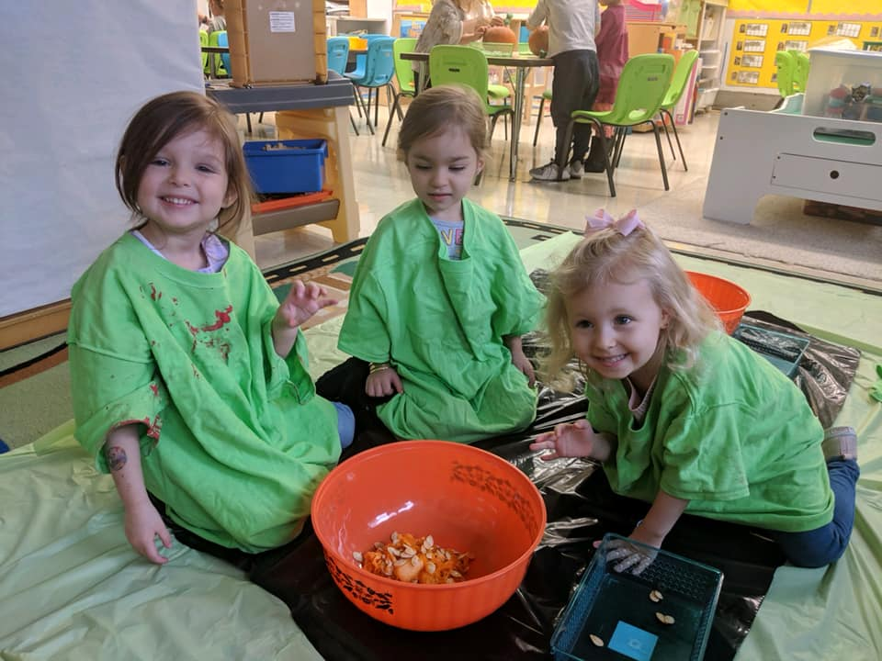
Our Game Plan
Dear St. Regis Families,
Over the course of the last months, our world has drastically changed and St. Regis Catholic School & Parish have been a beacon of community, commitment, strength, & faith. Thank you for being on this educational and faith journey with us as we navigate unchartered territory in the world of meeting the needs of our students.
Recently the AOD and State of Michigan released their ‘return to school safely plans.’ Our administration, faculty, and staff have worked tirelessly to implement the requirements and protocols into our school’s individualized plan.
Laid out to the right are the three scenarios within our plan. As long as we remain in Phases 4, 5, & 6 our instruction will be in our building. If we are in Phases 1-3, we will resume our robust distance learning program.
Given the ever-changing environment we are currently living in, we are aware that flexibility is key and we will always keep you updated if our plans need to shift.
Our top goals are; to keep everyone safe and to provide our students with what they need academically, socially, emotionally, and spiritually.
Scenarios
1Face-to-face learning following the governments most stringent requirements and protocols
(MI Safe Start Plan Phase 4)
2 Face-to-face learning following the governments stringent requirements and protocols
(MI Safe Start Plan Phase 5)
3 Distance Learning
(MI Safe Start Plan Phases 1-3)

Slide 3
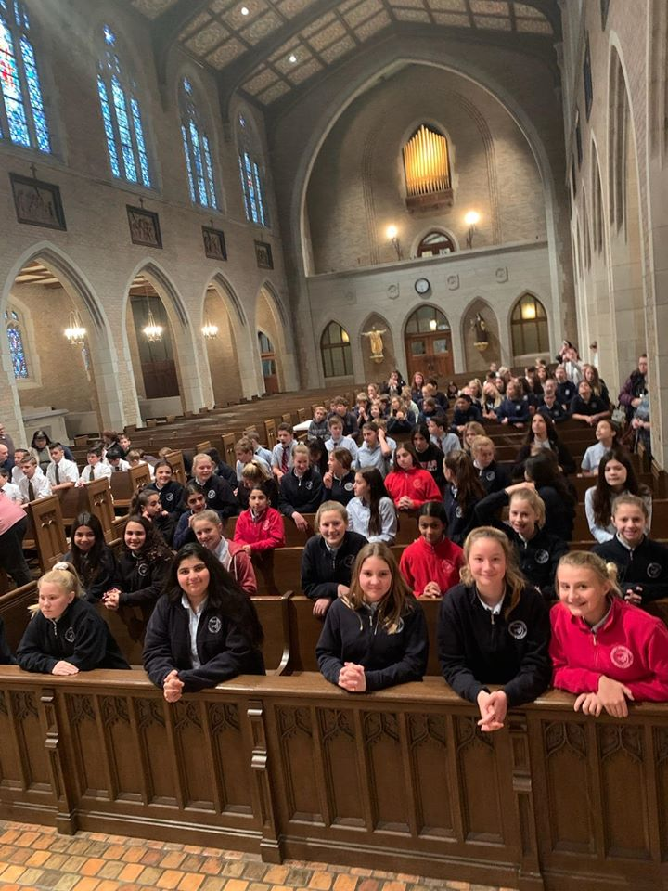
Safe re-entry into St. Regis
If the State of Michigan remains in Phase 4 of the MI Safe Start Plan, St. Regis Catholic School building will be open for in-person instruction starting on August 24th, 2020. Our first day of school will be a half day with dismissal at 11:30 a.m. Based on the AOD, CDC, and State of Michigan guidelines, St. Regis Catholic School is prepared to follow the protocols required. If the protocols change from these authorities, St. Regis Catholic School will adapt and implement our safety guidelines as needed.
Table of Contents:
COVID-19 Screening and Community Protection
What if Someone Tests Positive?
Personal Protective Equipment
Cleaning & Hygiene
Spacing, Movement, and Access
Drop off & Pickup Procedures
Visitors
Student Support
Distance Learning
Maintaining Our Catholic Identity
Our Commitment

Slide 4

COVID-19 Screening and Community Protection
As a community we need to be incredibly mindful of social distancing, mask-wearing, and limiting any possible COVID-19 exposure
Parents must check their child’s temperature daily. If the temperature is 100.3 or higher, the student may not enter our building or come to school
Any student who has shown COVID symptoms will not be allowed to return to school unless they have tested negative for the virus and have a doctor’s note
Any guest entering our building will be required to complete a self-monitoring form
All teachers will complete a self-monitoring form daily
Any child exhibiting COVID-19 symptoms will be quarantined in our front office in a separated section. They will wear a mask and a face shield until they are picked up
A guardian must pick up any child exhibiting COVID-19 symptoms immediately to limit further possible exposure
Symptomatic students must stay home
Daily at-home temperature checks for all students
A doctor’s note and negative test are required to return to school
Self-monitoring forms for all staff and guests in the building
Students feeling symptomatic will be quarantined
Students must be picked immediately if they are symptomatic

Slide 5
What if Someone Tests Positive?
We will cooperate with the local public health department regarding implementing protocols for screening students and staff and will follow their directives if someone tests positive
Symptomatic students and staff will be kept home until they have tested negative for COVID-19 and have been released from isolation according to CDC guidelines.
Families will be notified of the presence of any laboratory positive or clinically diagnosed cases of COVID-19 in the classroom and/or school to encourage closer observation for any symptoms at home. Individual family names will not be released out of privacy and respect for all.
Rooms will undergo deep disinfecting if a case has been present
Students in the same room as the positive case will need to be monitored for symptoms closely and kept at home if they exhibit any symptoms
Teachers will provide work and assistance for students at home in quarantine so they do not fall behind. This will be handled on a case-by-case basis.
Student or staff remains home until they test negative and have a doctor’s note to return
Student will be provided with work and support during quarantine situation
Student or staff tests positive for COVID-19

Slide 6


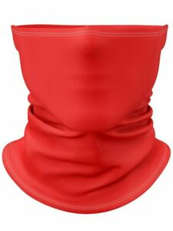
Personal Protective Equipment
Facial coverings may be homemade or disposable level one/basic grade surgical masks, and/or gaiters. Masks may also be purchased through our uniform providers.
All staff will wear facial coverings**
All staff and all students in grades pre-kindergarten and up will wear facial coverings when in hallways, common areas, and upon entering and exiting the building **
Facial coverings are not required in preschool classrooms by children ages 3 and 4.
All students in grades kindergarten through grade 5 will not be required to wear facial coverings in their classrooms, unless (1) students do not remain with their grade level throughout the school day and/or (2) come into close contact with students in another grade level (Preschool through 5th grade will be considered grade level cohorts, as long as they do not mix with other grade levels).
Students should always keep at least one extra facial covering in a sealed bag in their backpack.
Any student in grades preschool through 5th may wear a facial covering in the classroom if they choose.
All students in grades 6-12 will wear facial coverings **
All face masks and gaiters may not have inappropriate words or images on them. Solid colors are preferred. Land’s End offers a St. Regis face mask with our school logo.
**except (1) during meals and (2) unless face coverings cannot be medically tolerated as documented through written and signed verification by a physician

Slide 7



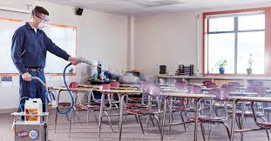
Cleaning & Hygiene
Maintenance will disinfect frequently touched surfaces including light switches, doors, and benches Throughout the school day
bathrooms, will undergo cleaning at least three times during the school day (every four hours) with either an EPA-approved disinfectant, diluted bleach solution, or our electrostatic sprayers.
Deep cleaning the building using electrostatic sprayers and EPA approved cleaners will occur each evening
Student desks will be wiped down with either an EPA-approved disinfectant or diluted bleach solution after every class period, or when cohorts change classrooms.
Playground structures will continue to undergo normal routine cleaning
We will ensure safe and correct use and storage of cleaning and disinfecting products (including storing products securely away from children and with adequate ventilation)
Each classroom will be supplied with: hand sanitizer, disposable gloves, disposable masks, EPA approved cleaning solution, tissues, paper towel, & Lysol Wipes
Signs and reminders will be placed throughout the building and in bathrooms reminding students to wash their hands properly
Early Childhood classrooms will continue to follow LARA guidelines for cleaning and sanitizing

Slide 8




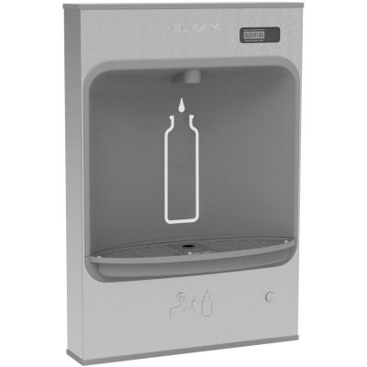
Spacing, movement, & access
Individual classrooms have been limited to 23 students or less (most classrooms are capped at 20 or less) to provide for proper social distancing between students.
Seats will be spread out as far as feasible
Plexiglass will be added to tables to separate students and provide a sneeze guard in our early school, science lab, and our classrooms utilizing tables (vs. desks)
Markings will be placed on the floors to indicate where students should stand in line or while waiting to get into a classroom
Specials teachers may travel to homerooms to minimize student movement throughout the building.
Gym class will be held outside whenever possible
We will limit the sharing of any school supplies
Our Academy will be released from class in a staggered manner to help hallway congestion
The lunchroom will have one grade level per day, per lunch period.
Students will eat in their classrooms most days.
Drinking fountains will not be accessible, only the bottle-filling stations will be accessible
At recess students may only be in one of four quadrants outside with members of their grade level/cohort

Slide 9

Drop Off & Pick Up Procedures
Detailed drop off and pick up procedures and protocols will be shared closer to the start of the school year in an email (i.e. which grade levels will enter through which doors)
Students are to report directly to their classrooms
Any parent or guest entering the building at drop-off must complete our screening protocol
Students may not arrive and enter the building earlier than 7:50 a.m.
Parents and students are asked to not gather anywhere on campus before or after school

Slide 10
Visitors & Late Lunches
The front office of the school will be limited to staff and students. Family members or non-staff members will not be allowed except for specific circumstances (i.e. picking up a sick child).
All guests that enter the building will be screened for symptoms, must wear facial coverings, and will fill out our monitoring form.
Parents will be notified (after attendance is taken) of a missing lunch.
A Cooler will be placed outside of our main door for forgotten lunches. Lunches will be delivered to individual students by a staff member.
Meetings with a staff member (administration or teacher) will be conducted by phone or virtually

Slide 11

Student Support
Mental Health and Well Being Support
Instructional Support
One of our school’s greatest gifts is our full-time on-site school counselor, Mrs. Mary Grobbel MSW.
Mrs. Grobbel will be able to help our students with any behavioral needs, including issues as the result of the Pandemic and self-care strategies that promote health and wellness.
St. Regis is incredibly blessed to have a full-time staff member running academic and instructional support. Mrs. Molly Lamarche is the head of our Learning Enrichment Center and will be able to address learning needs and make accommodations for our student body on an individualized basis.

Slide 12

Distance Learning
We are very proud of the way our faculty and staff rose to the challenge of online learning in the spring! We have taken your feedback from last quarter and are honing our program to be even more comprehensive
If distance learning is required (temporary or short term) students will engage in both synchronous (live) and asynchronous (available at any time) learning
Teachers will have recorded content and all work will be provided
There will be a very comprehensive LIVE teaching schedule for every grade level PK-8
Weekly pacing guide grids for all subject areas
A detailed description of what is to be covered daily
A strict turn-in schedule of assignments (late grades will be enforced)
Available technology for families that need it (iPad and Chromebook check out)
Social media connections and challenges
Grade updates on Whipple Hill weekly for parents to view progress
An expansion of our online learning platforms (e.g. Seesaw, Microsoft Teams, MyOn, Freckle, etc.)
Mass live-streamed weekly
Live prayer, pledge, and announcements daily
We are researching if we can offer an online option this fall for families not yet ready to return to face-to-face instruction. More information to follow.

Slide 13
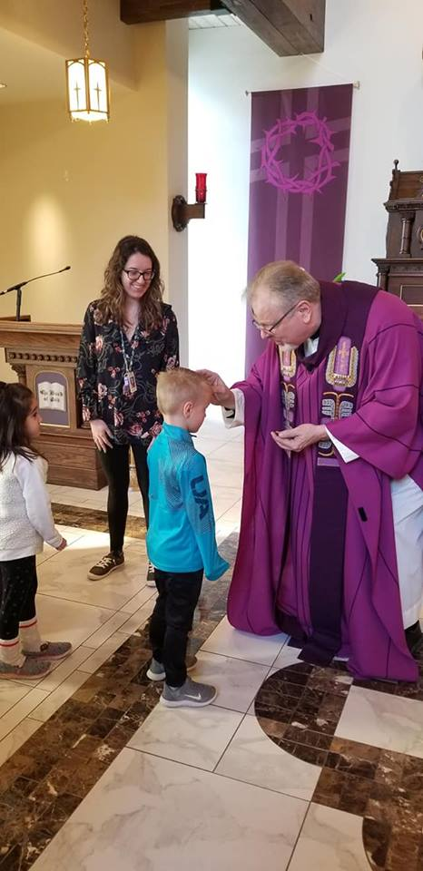
Maintaining our catholic identity
our Catholic faith is the reason for our school.
Whether it is face-to-face or online, St. Regis Catholic School and Parish pledge to:
Begin each day with prayer
Integrate our faith throughout our day
Be centered in following Christ in our interactions with students, staff, and parents
Celebrate Mass weekly (separating the school into 2 Masses to allow for social distancing)
Prepare our 2nd graders for Reconciliation and First Holy Communion
Prepare our 8th graders for Confirmation
Grow in our knowledge of the Catholic faith with a comprehensive religious education curriculum
Allow our Catholicity to permeate all that we do!
In all faith formation activities, we will follow state and AOD guidelines.

Slide 14
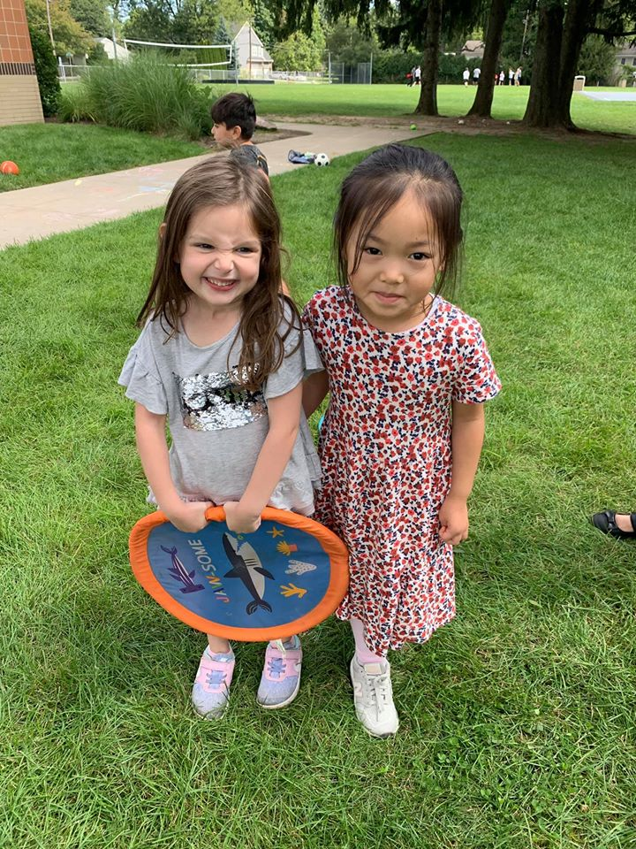
Our Commitment
Student Safety
Providing rigorous course work whether face-to-face or remotely
To be on our campus whenever safely possible.
To continue our rich, faith-filled St. Regis traditions and build more in the year to come.
We are here for YOU!

Slide 15
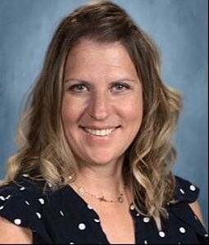
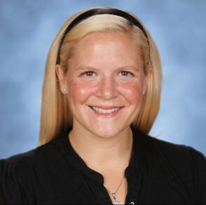

Questions?
At St. Regis, we realize that due to the nature of the pandemic, we will need to continually adapt to the most recent recommendations and requirements laid out before us. We will update you when changes need to be implemented. We pray that as we navigate through this time, we can work together as a team to stay safe, healthy, and unified. We thank God for you. We truly are an incredible community!
After reviewing this plan, please contact our school administration if you have any questions or concerns. We are offering face-to-face instruction at this time, distance learning in the event of a government closure, and will meet the needs of our students in quarantine. We are also developing a possible online fall option for families not ready to return to face-to-face learning. More information to follow for interested families. If you have any plan to change the status of your registration, please let us know because we have many grade levels on a growing wait list.
May God bless you and your families and may He guide us in wisdom always.
Sincerely,
Mrs. Katie Brydges
PRINCIPAL
katie.brydges@stregis.org
Mrs. Heather Sofran
ASSISTANT PRINCIPAL
heather.sofran@stregis.org
Fr. David Buersmeyer
PASTOR

Slide 16
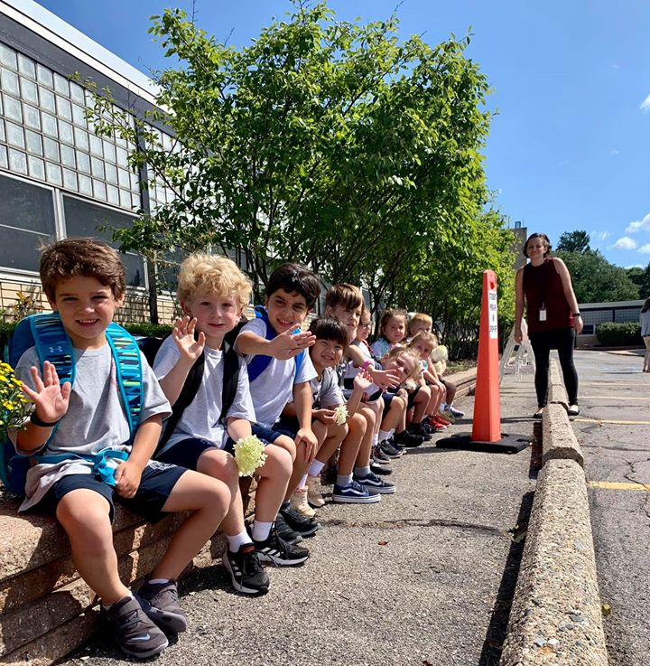
Thank you for partnering with us for the
2020-2021 school year!
We can’t wait to see you this fall!
May God Bless and Protect you and your families.

